Slide 1
Scaning Electron Microscope
Metalurgia Proyectos

Slide 2
Presentación
Video
https://youtu.be/af1VGKp0omA

Slide 3
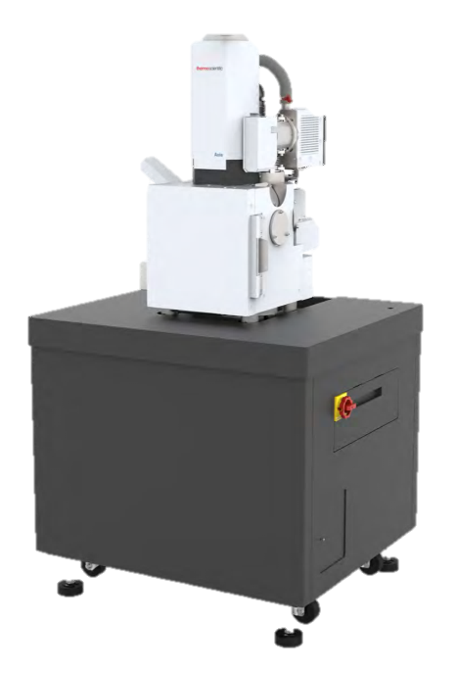
Axiachemisem, Thermo Scientific
BSE y SED detectors for contrast and composition analysis.
Knob or mouse operation.
120x120x55 mm compucentric stage, 10 kg max. weight.
High vacuum mode 3 nm at 30 kV (SE), 4nm with (BSE).
Low vacuum mode 3 nm at 30 kV (SE), 4nm with (BSE).
1,000,000X.

Slide 4
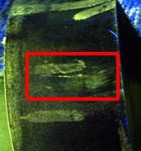
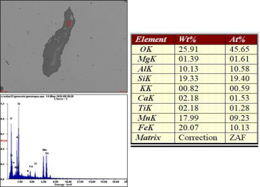
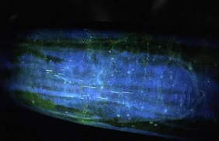
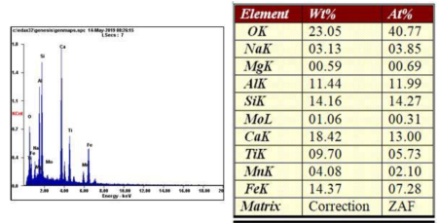
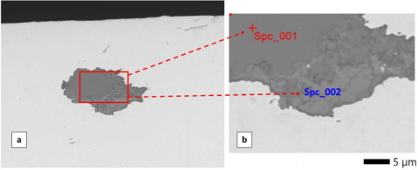
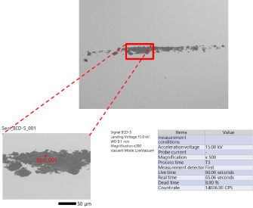
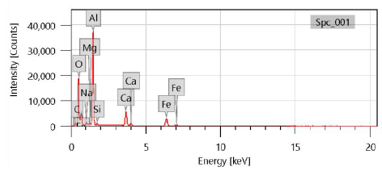
Succeed applications
Failure Analysis on CNH shaft.
Endogenous inclusions were found related to steel manufacturing process.
Failure Analysis due surface indications during magnetic particle inspection.
Indications are formed by Mg, Al, S and Ca due slag particles from melting parctices.
Metallugical evaluation of spindle due surface indication presence.
Al, Ca, Mg and Si content were found in the surface indications.
Non-metallic inclusion evaluations.
Al, Ca, Mg and Si

Slide 5
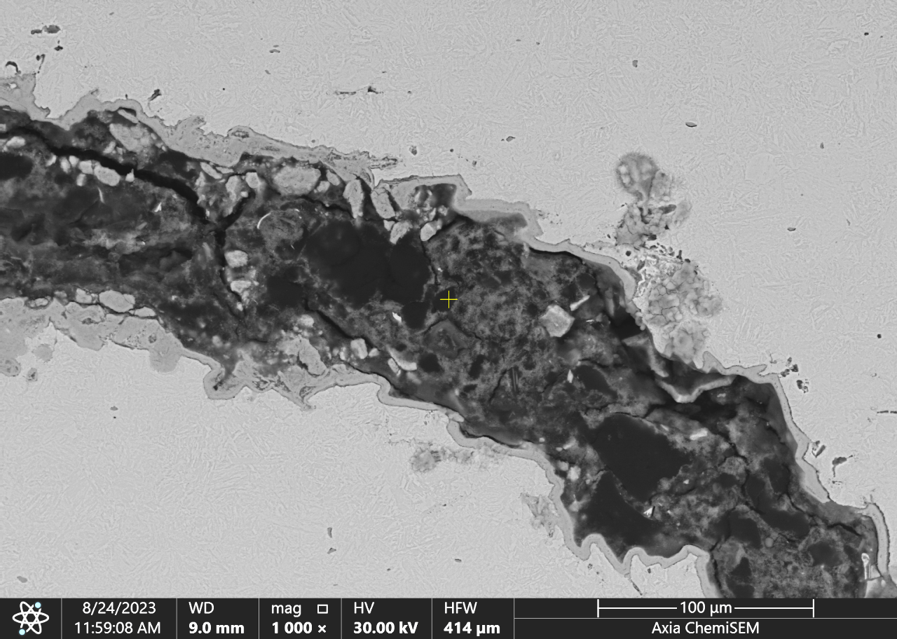
Grieta en barra de acero

Slide 6
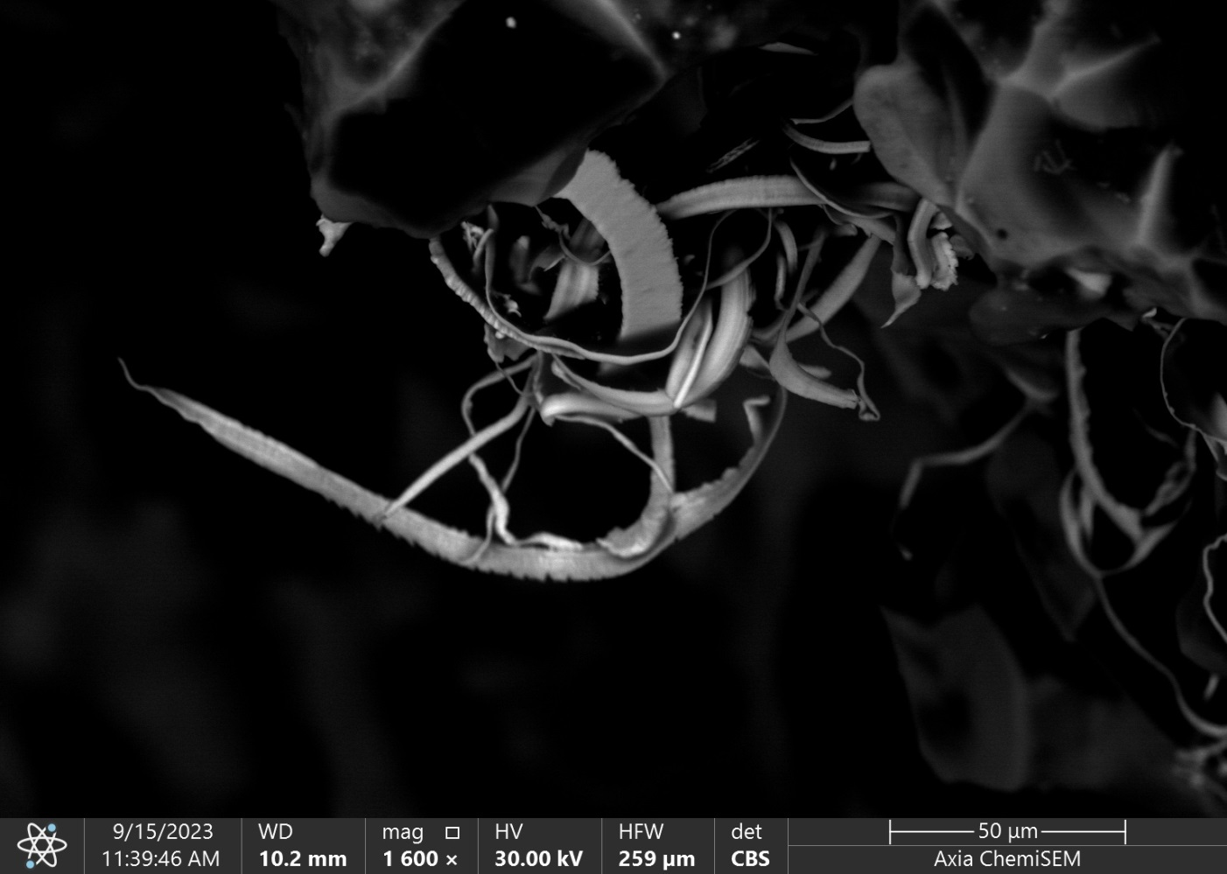
Viruta en piedra de rectificado

Slide 7
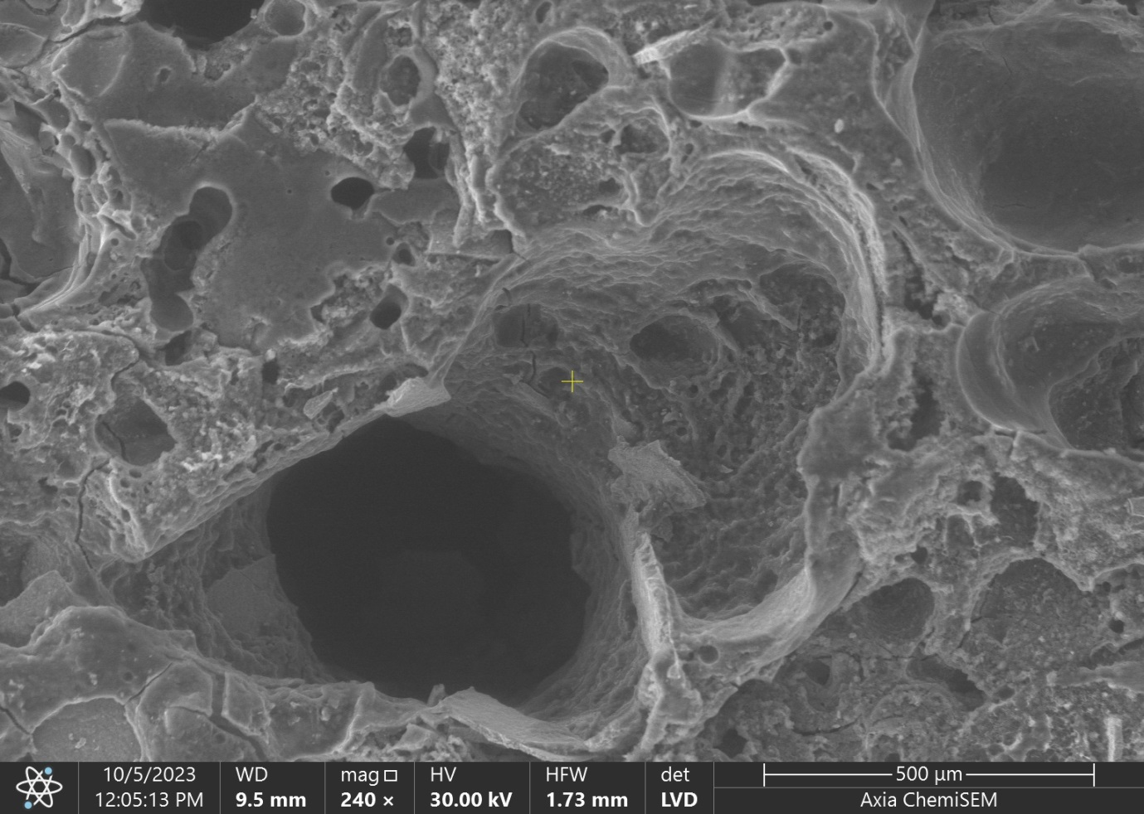
Cascarilla en formado

Slide 8
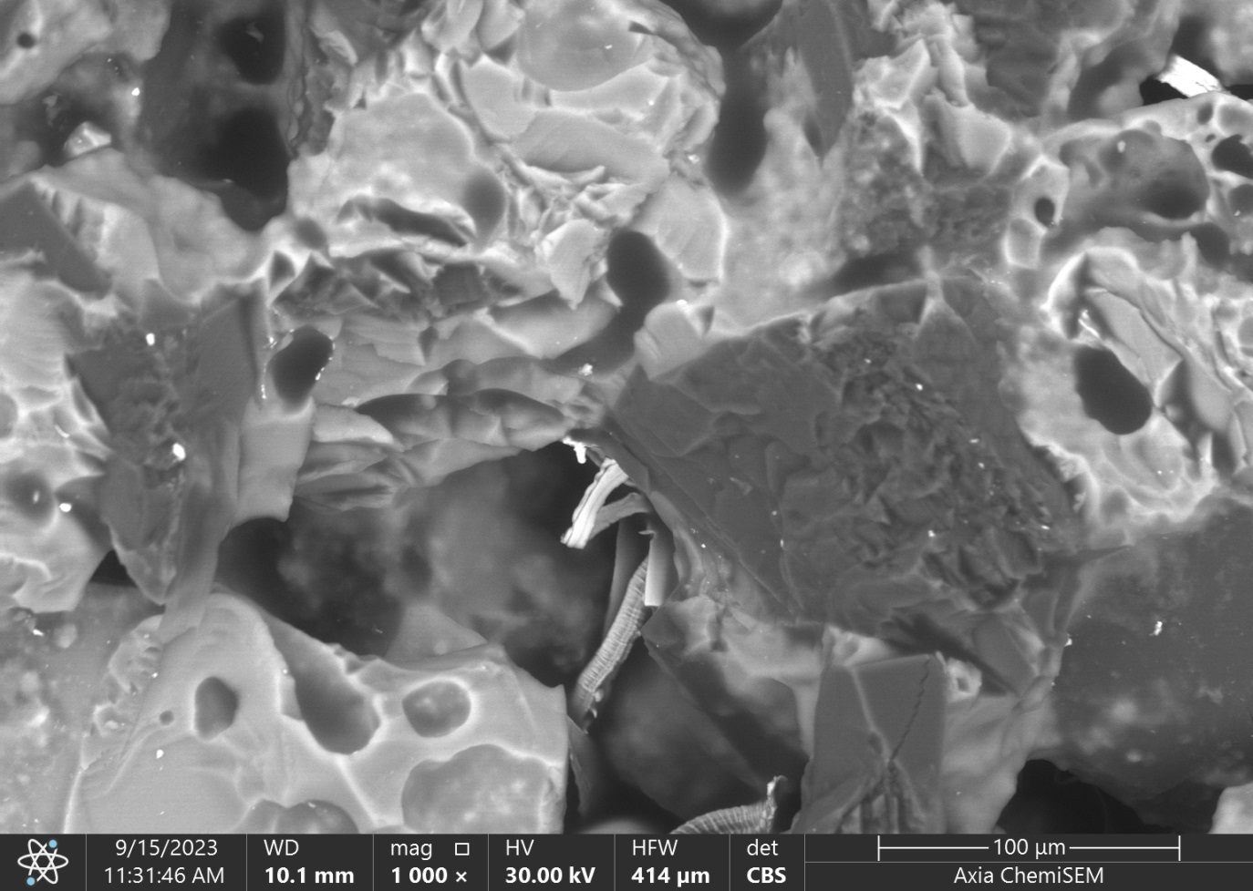
Piedra de rectificado

Slide 9
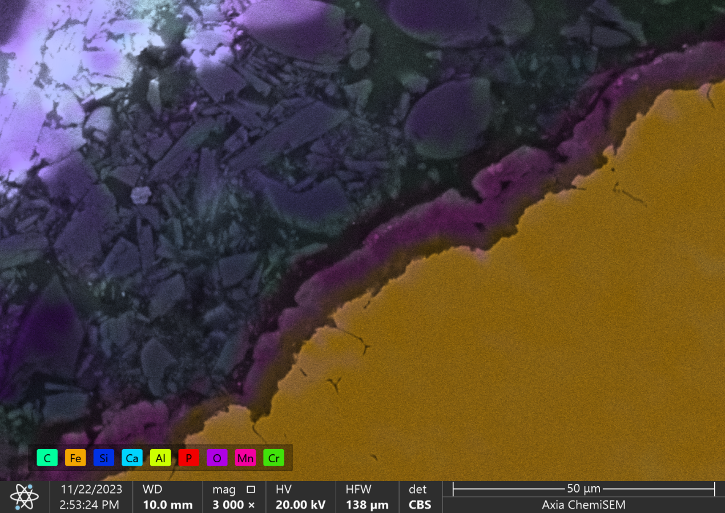
Análisis químico en capa de fosfatizado

Slide 10
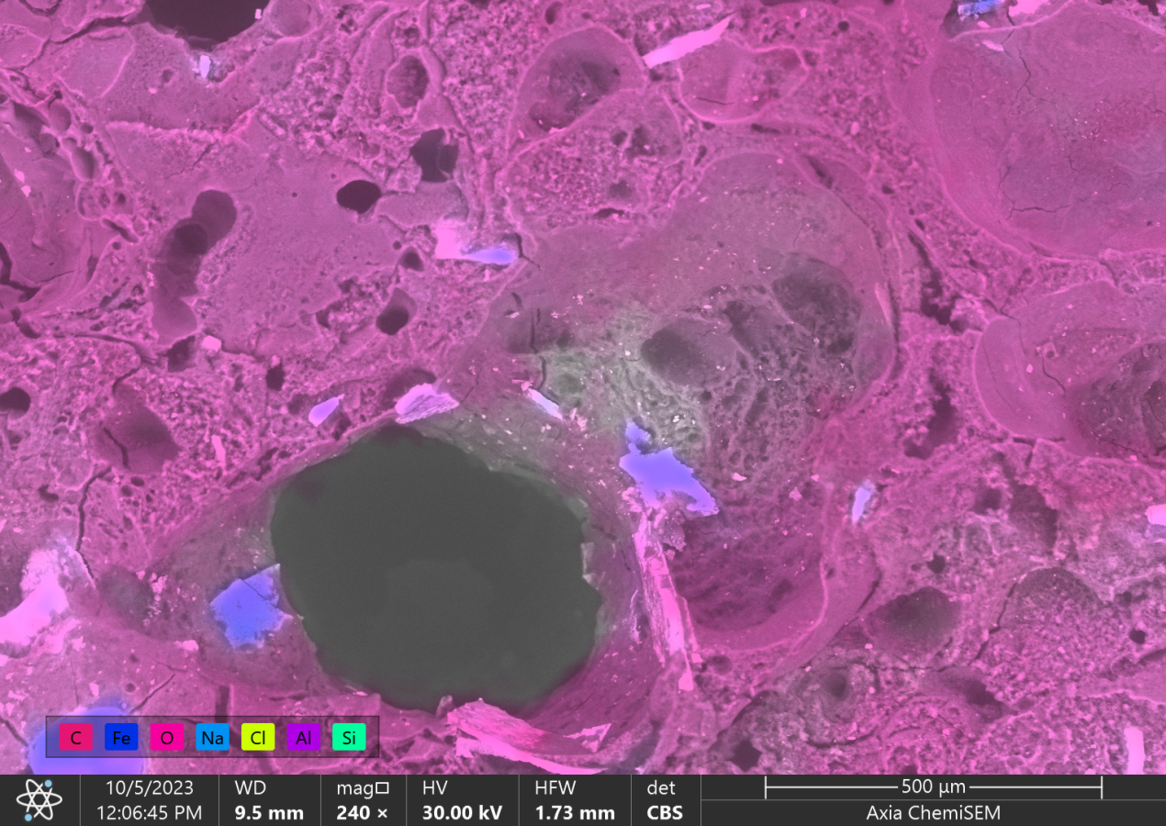
Análisis químico de cascarilla de formado

